Slide 1

Classification Project
Company goes Bankrupt or Not
Group – 1
Venkata Sai Raghava Varanasi
Yashraj Singh Rajawat
Sanjay Patil
Perugu Ridhi
Shaikh Ishrath Jahan
Sanamuskan

Slide 2
Introduction
This project is about training a machine learning classifier model that would tell whether a company with certain traits will go bankrupt or not.
The target is to understand different variables present in the dataset, clean the data, and understand the correlation each variable has with the target variable. This will come under the Exploratory Data Analysis or EDA part.
The next step is to train various models with a proper validation method for each model.
Once the models are trained the final step will be to deploy a website where the model will give live predictions on new input data.
Here, the main goal is to find out whether company will go bankrupt or not with the help of certain parameters pertaining to the company. We have the data of these parameters from 250 companies and their bankruptcy state. Using this data the models will be trained so that they can predict whether a new company will go bankrupt or not.

Slide 3
Part 1 - EDA

Slide 4
Exploratory Data Analysis - EDA
The EDA part consists of understanding the data, finding missing values, correlations, presence of outliers in the data.
So, the variables present in the dataset are:
Industrial Risk - a negative parameter. The more it is the more risk the company faces.
Management Risk - a negative parameter. The more it is the more risk the company faces.
Financial Flexibility - a positive parameter. The more it is the less risk the company faces.
Credibility - a positive parameter. The more it is the less risk the company faces.
Competitiveness - a positive parameter. The more it is the less risk the company faces.
Operating risk - a negative parameter. The more it is the more risk the company faces.
Next is to check for null values and data type errors. And there are no null values and no data type errors in the data.
The Class column which is a categorical one with values 'bankruptcy' and 'non-bankruptcy' is encoded into 0 and 1 respectively for the two classes.

Slide 5
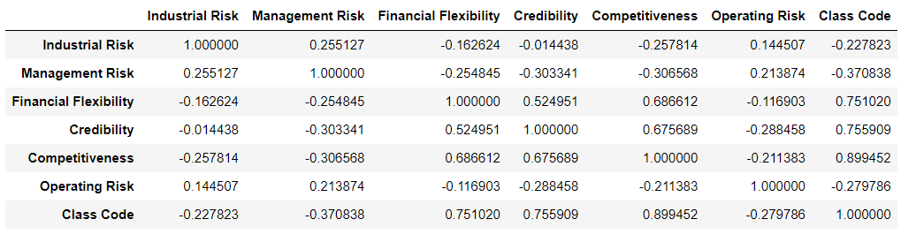
EDA Continued - Correlations
After the encoding is done, the next step would be to check for correlations. In these correlations the variables Financial Flexibility, Credibility, and Competitiveness are found to have positive and high correlation with the Class.
And the variables Industrial Risk, Management Risk, and Operating Risk have negative correlations with the Class.

Slide 6
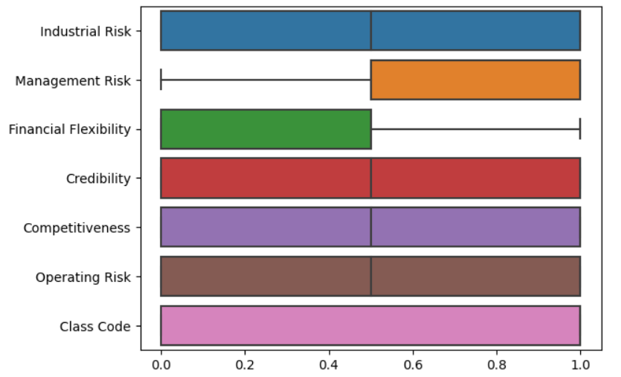
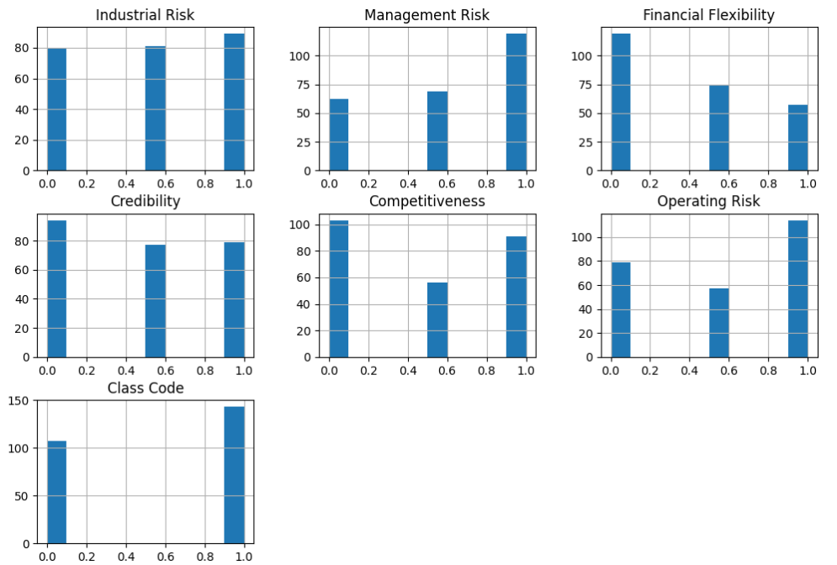
EDA Continued – Outliers and Distribution
From the box plots we found that the data does not have any outliers.
As for the distribution all the data is distributed among 3 values which are 0 for low magnitude, 0.5 for medium magnitude, and 1 for high magnitude for all the independent variables.

Slide 7
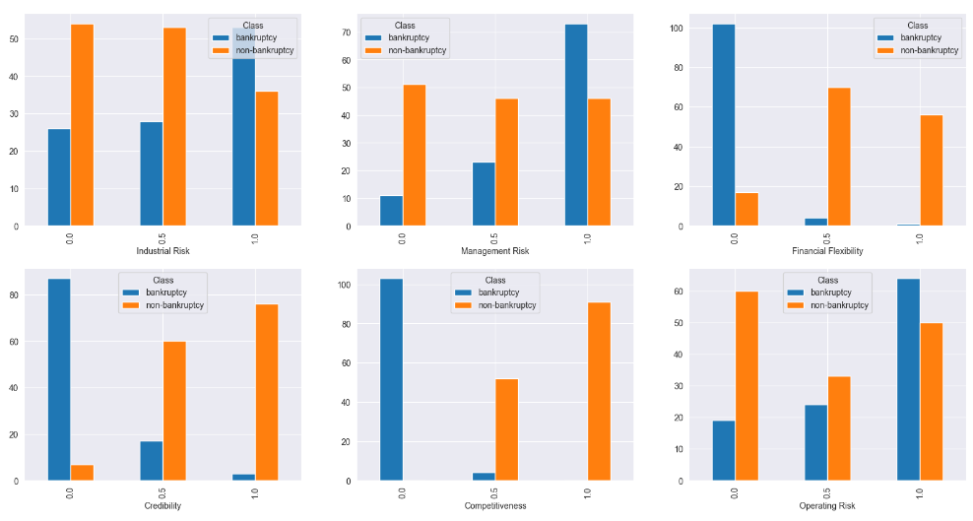
EDA Continued – Cross Tables
The cross tabs are used for understanding how each independent variable is impacting the target variable.
We found that when the three positive variables have a value of 1 there is a high chance the company will not go bankrupt and vice versa.

Slide 8
Part 2 – Model Building

Slide 9
Different Models Trained
These are the different models that are trained for making predictions.
Equation or Parameter based models
Logistic Regression
Non – Parametric models
Decision tree Classification
Random forest Classification
K Nearest Neighbors Classification
Support Vector Classification – with linear, poly and rbf kernels
Bagging ensemble Classification
AdaBoost ensemble Classification
Gradient Boost Classification
Stacking ensemble Classification
Artificial Neural Networks

Slide 10
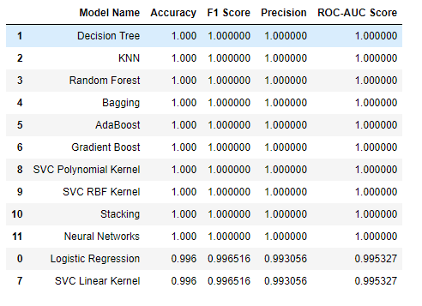
Evaluation Metrics
The different evaluation metrics that are used in a classification problem are accuracy, f1-score, precision, recall, confusion matric, roc-auc score.
Among these the accuracy and the f1-score are very important ones. So, the performance of the model can be evaluated using these 2 metrics.
Here we can see all the trained models and their corresponding accuracies and f1 – scores arranged in the descending order.
Almost all models gave a 100% accuracy and f1 - score.

Slide 11
Part 3 - Deployment

Slide 12
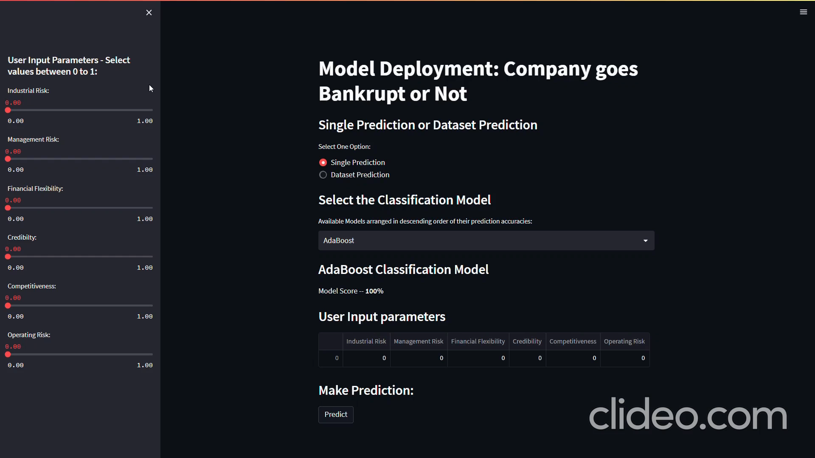
Deployment
The final step is the deployment of the trained models for making live predictions.
The live prediction site has the options to make a prediction for a single observation and also for the entire dataset. The user can choose one.
The user can also choose between the different classifiers mentioned previously. The accuracies of all the models can be seen there.
For the single predictions the user can select the values of the variables and make the prediction with the selected classifier.
For a dataset prediction, the user shall upload the dataset and make the predictions for the entire dataset and download the predictions.
The overall functioning of the deployed site can be seen in the video.

Slide 13
Thank You

